Slide 1
Improved visualization Technology using AI
Course Coordinator:-
Ramchand Hablani
Prepared by
Ambarish Hariadas
Vikas Shahu
Vyankatesh Haridas

Slide 2
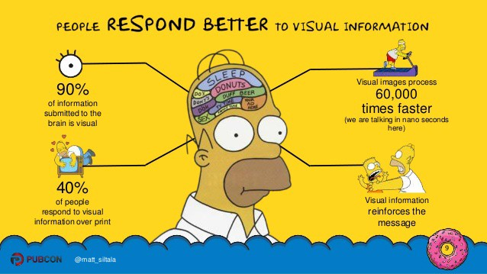
Improved visualization Technology using AI

Slide 3
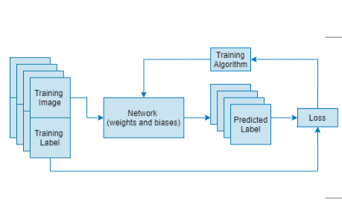
Output

Slide 4
Applications
Text to Scene
AR Social Media(transform yourself into a cat or dog or a Disney princess)
( it appear on the screen as something more than it is in real life)
Virtual reality is a form of interaction between humans and computers in which a real or imaginary
environment is simulated. Users interact with that world and manipulate it.
Satellite Imaging
MRI Reconstruction Using Deep Bayesian Estimation

Slide 5
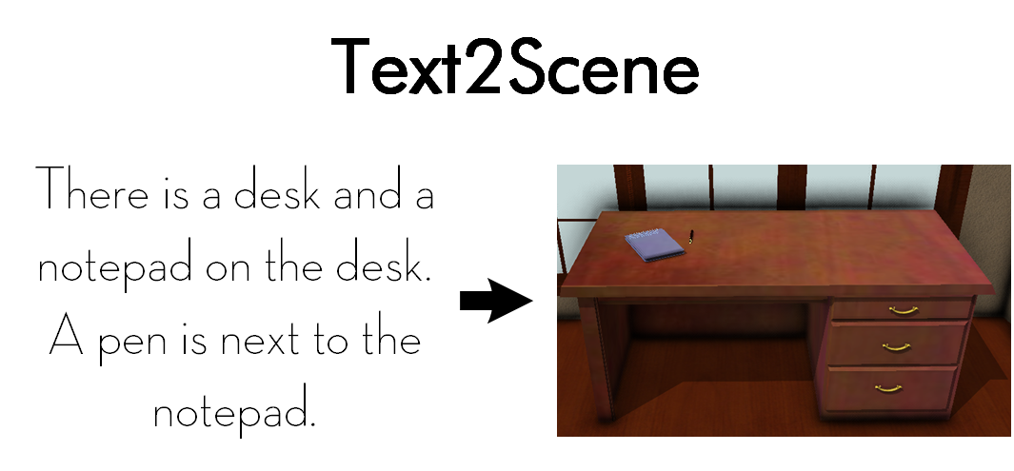

Slide 6
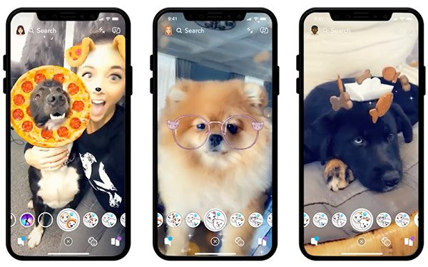
AR Social Media(transform yourself into a cat or dog or a Disney princess)
( it appear on the screen as something more than it is in real life)

Slide 7

Making 3d video of 2d images using AI (VR)
Virtual reality is a form of interaction between humans and computers in which a real or imaginary environment is simulated. Users interact with that world and manipulate it.

Slide 8
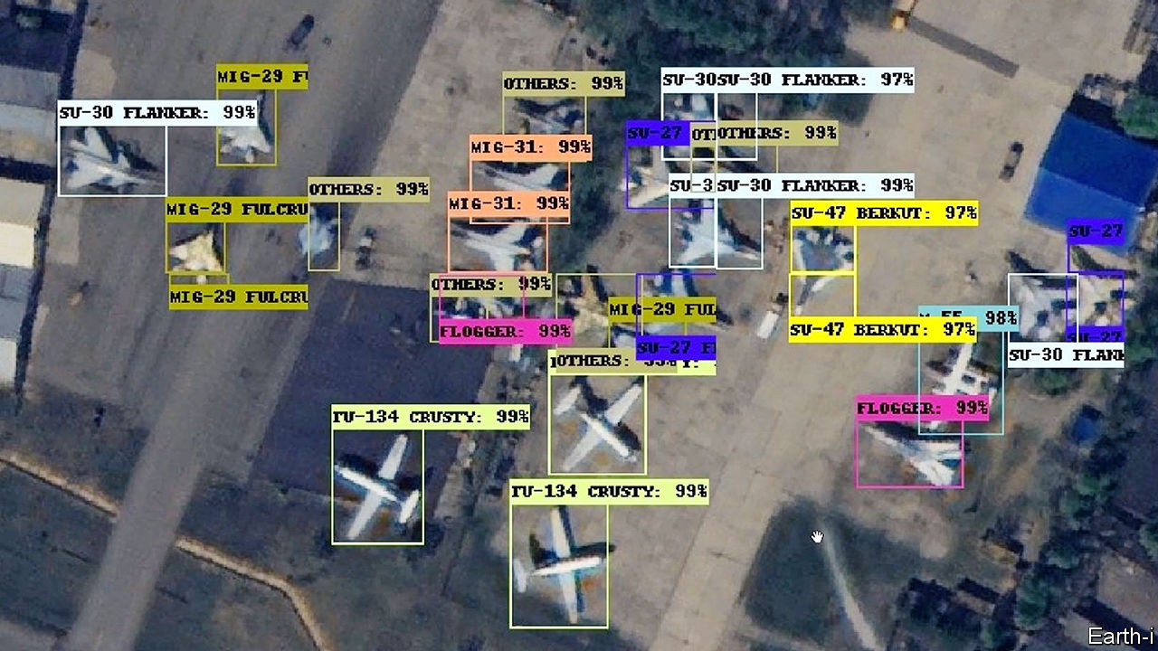
Satellite imaging, in combination with aerial images and AI, could be used to observe and measure events like topmost tree thinning, loss of undergrowth native vegetation, etc. Applications of AI through machine learning can also be used to measure alterations in water levels. Furthermore, the development of new vegetation in areas that are being revived can also be tracked by artificial intelligence technology.

Slide 9
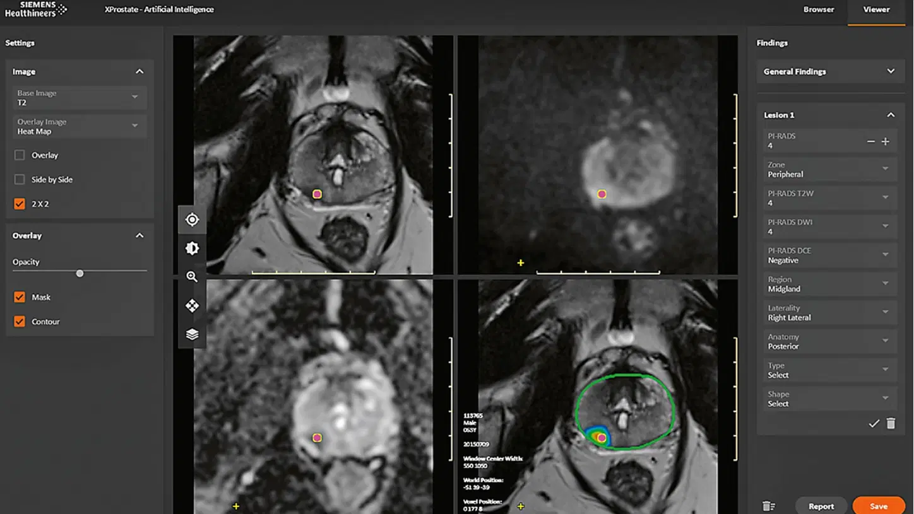
MRI Reconstruction Using Deep Bayesian Estimation
The image reconstruction from incomplete k-space measurement was obtained by maximizing the posterior possibility

Slide 10
Conclusion
AI is reshaping the world by visualization. It is being used by military, madical, education and gaming. It is copying human behaviour so that human can interpret things easily and it is making human to visualize process those were previously impossible to visualize like transforming 2d objects into 3d object.

Slide 11
References
https://arxiv.org/abs/1909.01127
https://towardsdatascience.com/visualization-helps-us-run-with-the-ai-b0cd64e34eb9
https://www.newscientist.com/article/2294737-ai-can-turn-a-collection-of-2d-images-into-an-explorable-3d-world/
https://onlinelibrary.wiley.com/doi/abs/10.1002/mrm.28274

Slide 12
Thank you….

